Slide 1
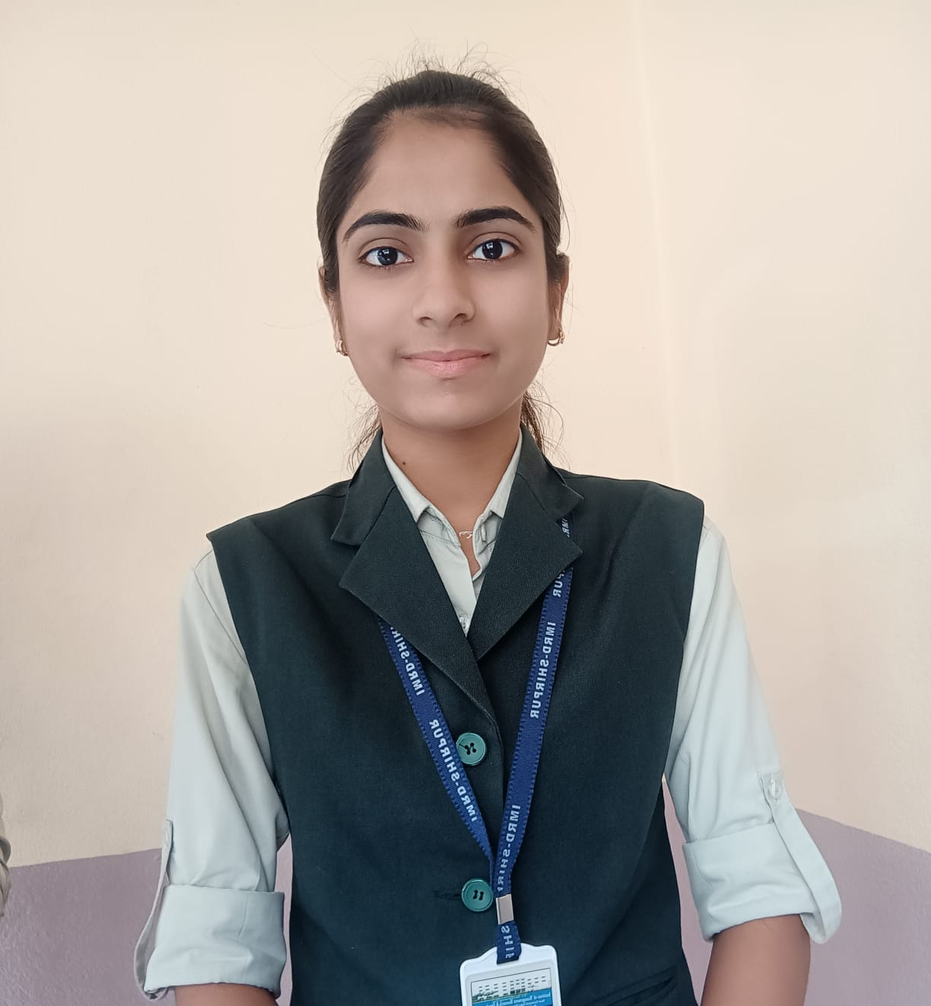




S A K S H I P A T I L
Aspiring Data Analyst
sakshipatil9072@gamil.com
8799991671
CAREER OBJECTIVE
Aspiring data analyst with knowledge of tableau, visualizations, SQL and python to align with new edge technologies that helps to growing me along with my company.
PROJECT
PERSONAL DETAILS
Date of birth
Nationality
: 03 February 2004
: Indian
Address : Shirpur, Maharashtra
https://www.linkedin.com/in/sakshi-patil-496904261/
PROJECT 1
Ecommerce Sales Dashboard
This complete dashboard will be operated by using two Dynamic filters or two Quick filters .Market filters and Action filters
https://public.tableau.com/app/profile/sakshi.patil4360
.I have used in different KPIs,Sparkline,charts.
Object Detection
The objective is to object detection is computer vision technique that work to identify and locate objects within an
image or video.
https://github.com/Sakshi03022004
PROJECT 2
TECHNICAL SKILLS
Java
90%
Image recognition assigns a label to an image.
Tableau
80%
C #. Net
90%
EDUCATION 2021 – 2023 | RCP IMRD | NMU Bachelor's in Computer Application. | Shirpur
 | Computer Science | 87.90%
2020– 2021 2018– 2019 | Dr.P.R.Ghogrey Junior College | Nashik-Board HSC | 89.83% Sane Guruji Vidyalaya | Nashik-Board SSC | 85.20% | Shirpur Vikharan
SQL
85%
C++
90%
HTML ^{90%}
CERTIFICATIONS AND TRAININGS _{EDUCATION}
.
Tableau Training
Jan 2023- Feb 2023
Java Training
Besant Technologies
Feb 2023 – April 2023
Python Training
Besant Technologies
Nov 2022 – Jan 2023
ACHIEVEMENTS
I received a certificate for participated in MaTPO Aptitude Idol-2023.
HOBBIES AND INTERESTS
Listening to Song
I received a certificate for completing a course in java.
Drawing

